Slide 1
Welcome
Meeting for Parents of New Junior Infants

Slide 2
Partnership between school and home.
Partners
Online app for school payments EOLAS
www.coilldubhns.ie

Slide 3
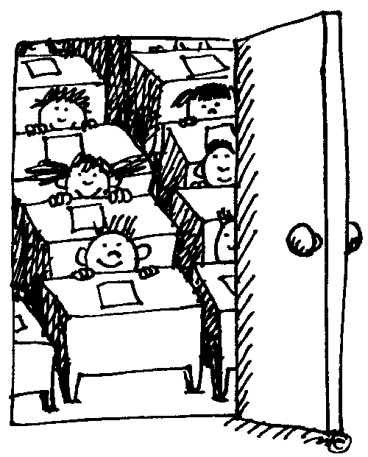
Regular Communication
Getting Involved
Seesaw app to contact teacher
Attendance
Punctuality

Slide 5
Uniform
Boys
Grey trousers (easy fastenings)
Wine jumper
White shirt (short sleeves)
Wine tie
Black shoes (With Velcro fastenings)

Slide 6
Girls
Grey skirt/ pinafore/ trousers
Wine jumper/ cardigan
White shirt (short sleeves)
Wine or grey socks/ tights
Black shoes

Slide 7
White polo shirts with tracksuits on PE days
Tracksuits can be ordered at schoolwearhouse.ie link available on the school website
Large old shirt for painting

Slide 8
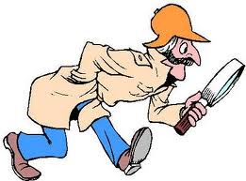
Practise putting on coat and jumper
Label everything
Put a small badge/ button/ ribbon on labels

Slide 9
Lunch
Separate lunch bag. No food/ drinks in school bag. Two free school snacks are available each day and need to be ordered in advance using the Lunchbag App.
Healthy Eating Policy
Part of SPHE curriculum
Children learn better with a healthy lunch
Environmentally friendly packaging

Slide 10
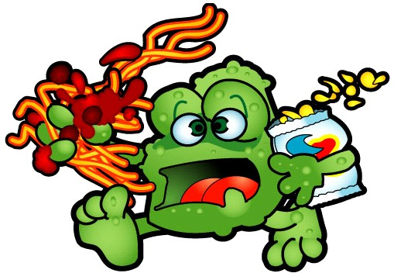
Not permitted, except on Friday
Bars of any sort
Biscuits
Sweets
Not permitted at all
Crisps
Fizzy drinks

Slide 11
Allergies
Please avoid lunches containing the following foods
Nuts
Peanut butter
Chocolate spread
Cereal bars which contain obvious nuts

Slide 12
On treat day it is fine to send in one small treat with the warning “May Contain Nuts”
Please try and avoid the obvious
Snickers
Yellow M&Ms
Kinder Bueno chocolate bars
Any treat with obvious nut content
Please do not send crisps to school.

Slide 13
Health and Hygiene
Make sure your child can use the
toilet and asks in plenty of time
Teach them how to wash their hands after toileting
Show them how to deal with runny noses and tissues
Check your child’s head regularly for head lice. They are a fact of school life and regular checking can help everyone stay nit free!

Slide 14
Skills for School
Read to your child every night
Talk to your child
Help your child to recognise his/ her name
Encourage your child to draw and scribble
Practise throwing and catching a ball
Provide lots of opportunities to run and climb.
Encourage independence
Provide opportunities to play with other children

Slide 15
The First Days
Be positive about the school and teacher
Don’t hype up the first day too much
On the first day keep everything calm
Say a quick happy goodbye
Remind your child that you will be back soon

Slide 16
The First Weeks
Be on time for collection
Try to get a good bedtime routine going
Ask specific questions about school
Punctuality
Check the school website for information on policies/ notes/ upcoming events and photo archives
www.coilldubhns.ie

Slide 17
School starts back on Wednesday 31st of August @ 9.00am Junior infants will finish at 12 noon until Friday 9th of September. After that school finishes for Junior Infants at 1:40 pm each day

